Slide 1
for American Indian and Alaska Native (AI/AN) Elders
August 24, 2015 Copyright National Indian Council on Aging, Inc.
Notes:
Music playing as people enter
Stretch briefly
Go around room. Tell us your name and a little about what you do
Hello everyone!
We are very excited to share this new directory we are developing and ask for your participation.

Slide 2
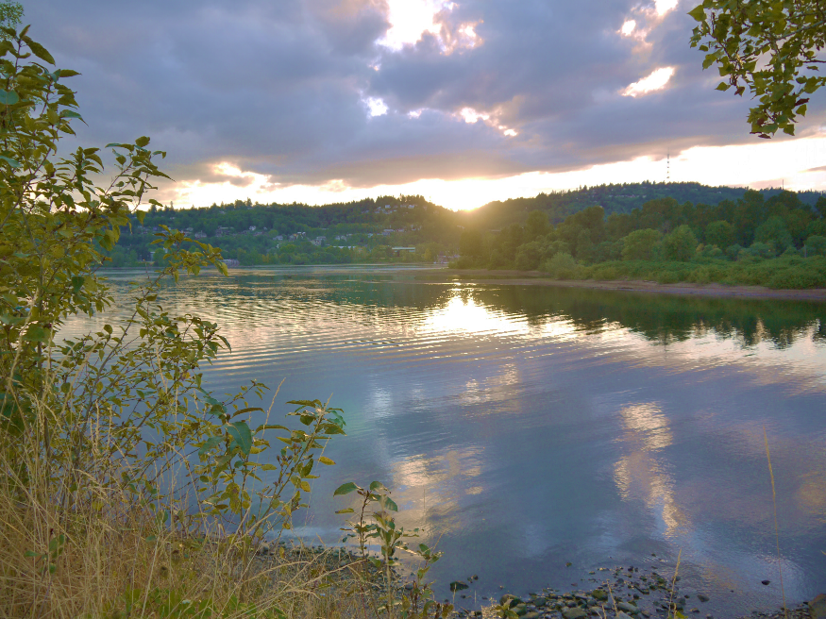
Our call is to…
To provide American Indian and Alaska Native Elders
comprehensive information on critical health and social service resources within and beyond Indian Country
so they can live with honor, dignity and quality of life
and remain in their own homes and communities as they age
Notes:
NICOA is a national, 501 c3 nonprofit organization.
Membership is open to anyone 55 and over who is enrolled in a federally recognized tribe, pueblo or nation.
We are governed by a 13 member Board of Directors which represents the NICOA membership.
We are based in Albuquerque in the NE heights.
NICOA began in 1976 with the National Tribal Chairman's Association and a conference held in Phoenix Arizona.
The conference was titled: The Indian Elder: A Forgotten American

Slide 3
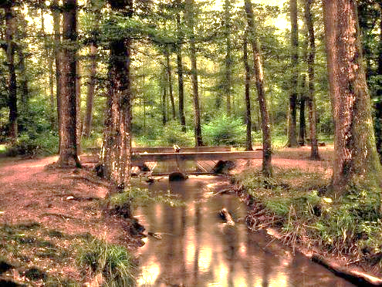
Our aim is to bridge the gaps in service for AI/AN Elders
Improve the ability of Elders and their caregivers to make informed decisions based on comprehensive resources and services
Educate the Aging Network about the scope of available specialized care and services for Elders and their caregivers, including Tribal, State, and Federal services
Work collaboratively with the Aging Network to link and coordinate services within and beyond the boundaries of Indian Country
Notes:
Christine and I are working on a grant with the Dept. of Health and Human Services.
The major goals of the grant are listed above.
Define the Aging Network.

Slide 5
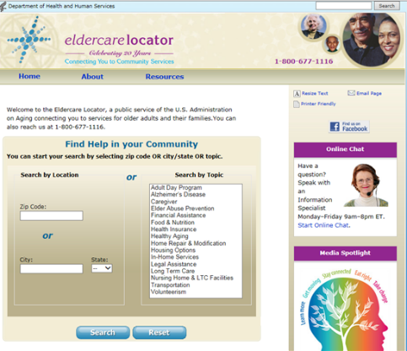
Eldercare Locator is the main resource directory for Elders in the U.S.
Eldercare Locator is administered in partnership with the Administration on Aging and the National Association of Area Agencies on Aging (n4a)
Primarily focused on services delivered through Area Agencies on Aging which may not cover Indian Country
Limited information for American Indian and Alaska Natives in their tribal areas
Notes:
Began in 1992
Goal is to help people find local agencies and programs in every US community
2 components: national call center and website
It provides help when you don’t know where to start
Originally thought it would be used mainly by professionals, but 76% of callers are older adults
Helps adult children who need to arrange for services for parents needing care
Good resource for someone unfamiliar with the aging network of services

Slide 6
Eldercare Locator is an easy to use directory that helps people find services close to them
Adult Day Program
Alzheimer’s Disease
Caregiver
Elder Abuse Prevention
Financial Assistance
Food & Nutrition
Health Insurance
Healthy Aging
Home Repair & Modification
Housing Options
In-Home Services
Legal Assistance
Long Term Care
Nursing Home & LTC Facilities
Transportation
Volunteerism
Notes:
They are open M-F 9:00 am – 8:00 pm EST
Information specialist and master level counselors
Bilingual
Reliable resource to help older adults find services

Slide 7
Eldercare Locator was designed to cover the entire country by dividing it up by state and then by Area Agency on Aging
When you call Eldercare Locator they will give you the phone number for your local Area Agency on Aging and other services based on your needs, for example: transportation or in-home care
It can be a challenge to find the resources closest to those living in remote Tribal Areas such as the Navajo Nation which spans 3 different states: Utah, Arizona and New Mexico

Slide 8
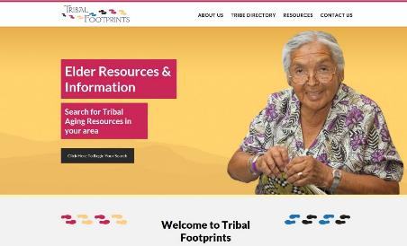
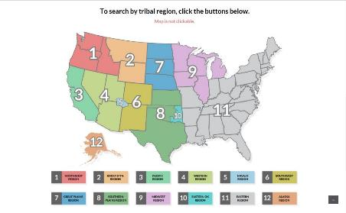
In response to this gap in information NICOA has initiated the development of

Slide 9
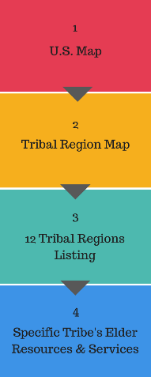
How Tribal Footprints.org will work

Slide 10
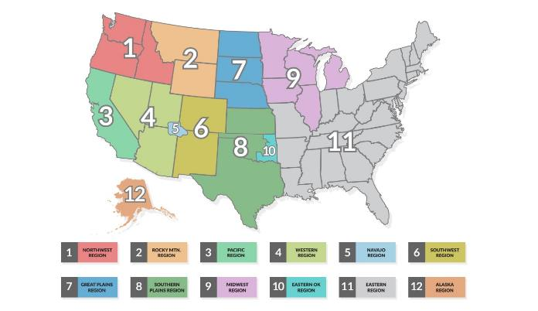
Elder friendly navigation
Elders will also be able to locate services where they live
throughout all 12 Tribal regions

Slide 11
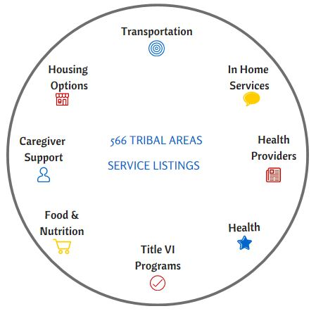
Categorized Links
Links to address specific Elder needs categorized by
Tribal name
Region
State
Community service category

Slide 12
Free and Simple to Use
Free, easy access at any time for anyone with a smart phone or other computer device

Slide 13
Link and Coordinate Services with the Aging Network
within and beyond the boundaries of Indian country

Slide 14
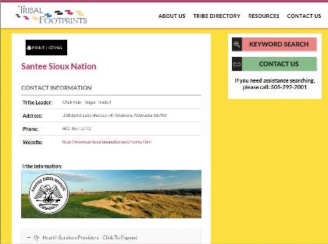
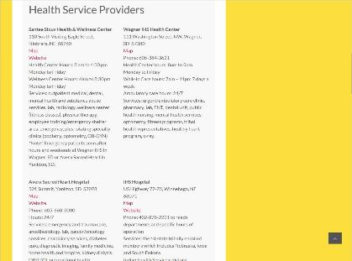
Example of a Tribal webpage:
Tribal contact information and location map
Area service and resources listings with links
May also include photos, Tribal seal or logo
The ultimate goal is to have all 566 tribes included in our directory

Slide 15
Momentum is building! NICOA gratefully acknowledges the following Tribes for agreeing to participate in the Tribal Footprints Resource Directory!
Pala Band of Mission Indians Pleasant Point Passamaquoddy Tribe Pomo of Upper Lake Pueblo of Isleta Pueblo of Pojoaque Pueblo of Zuni Qagan Tayagungin Tribe Qawalangin Tribe of Unalaska Resighini Rancheria Round Valley Indian Tribes Santee Sioux Nation Shoshone-Bannock Tribes Spirit Lake Tribe of North Dakota Susanville Indian Rancheria The Hopi Tribe Valley Miwok Tribe Wyandotte Nation
Atmatluak Traditional Council
Comanche Nation of Oklahoma
Cow Creek Band of Umpqua Tribe of Indians
Crow Creek Sioux Tribe
Elko Band Council, Western Shoshone Indians of Nevada
False Pass Tribal Council
Hoopa Valley Tribe
Lac Courte Oreilles Band of Lake Superior Chippewa Indians
Makah Tribe
Modoc Tribe of Oklahoma
Native Village of Nunam Iqua
Nondalton Tribal Council
Nulato Tribal Council

Slide 16
Elder friendly website with a Tribal Regions map to readily search 566 Tribal area resources
Free and easy access at any time for anyone with a smart phone or other computer devices
Localized listings of critical health and social services and resources for American Indian/Alaska Native Elders
Link and coordinate services with the Aging Network, within and beyond the boundaries of Indian country
Links to address specific Elder needs, categorized by tribal name, region, state and community service category

Slide 17
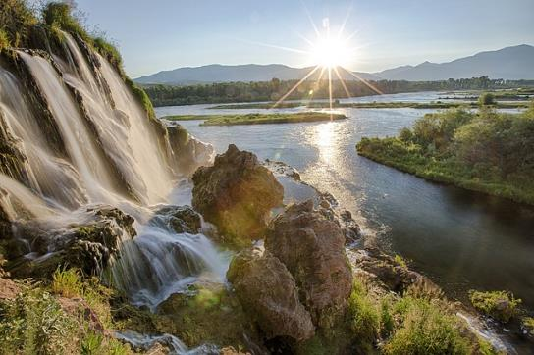
Why use Eldercare Locator and Tribal Footprints?
There is a great need for reliable Information and Referral
Misinformation: for example, many Americans think Medicare will pay for Long Term Care
2/3rds of Americans lack knowledge about available programs and services
Most Americans vastly underestimate the cost of care
Educate the Aging Network about the services available in Indian Country
August 3, 2015 Copyright National Indian Council on Aging, Inc.

Slide 18
What types of requests does Eldercare Locator receive?
19% Transportation
18% Home and Community Based Services
15% Housing
11% Medical Services and Supplies
9% Health Insurance
Other: legal and tax assistance, elder abuse, long term care, caregiver resources, employment services
Escalated Calls, requiring more expertise
37% long term services and supports
29% caregiver services
27% elder abuse
August 3, 2015 Copyright National Indian Council on Aging, Inc.

Slide 19
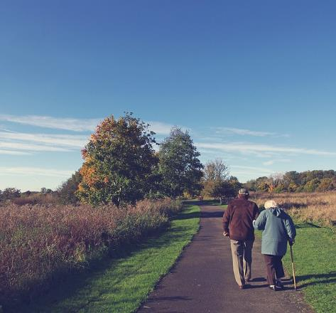
Who contacts Eldercare Locator?
76% are looking for information for themselves
74% are elder women who live alone, may be vulnerable and more likely to be poor
22% family members
3% neighbor or friend
3% professional
August 3, 2015 Copyright National Indian Council on Aging, Inc.

Slide 20
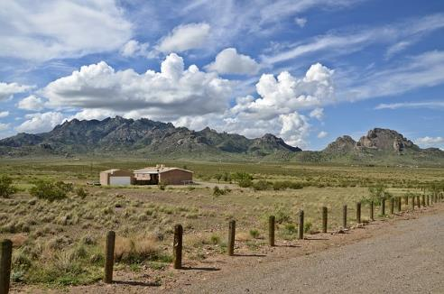
What’s happening in your community?
What is working well?
Where do you see a gap in Elder services and resources?
What is one possible solution to this gap?
Are there any emerging challenges you’re seeing on the horizon?

Slide 21
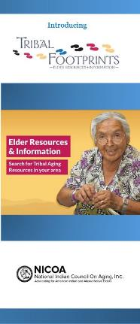
Join us!
Help build a comprehensive picture of AI/AN Elder services and resources throughout Indian Country, so Elders can remain in the own homes and communities as they age
Reach urban AI/AN Elders as we partner with Eldercare Locator to provide the best source of information for Elders beyond the boundaries of Indian Country
Sign the Release Agreement to allow your local government contacts and aging related services to be available nationwide on Tribal Footprints.org
Have your Tribe featured on our free personalized webpage as part of the 566 Tribal Area Aging Service Listings
For more information: Becky Owl Morgan, NMAO-TAC Project Coordinator rmorgan@nicoa.org Phone: 505-292-2001
For a similar Power Point go to nicoa.org/tribalfootprints.org/
August 24, 2015 Copyright National Indian Council on Aging, Inc.

