Slide 1
Understanding Disabilities in Native Communities

Slide 2
Introductions
Desiree Lapahie, Data Analyst NICOA
Rebecca Owl Morgan, Project Coordinator NICOA
Amy Nicholas, Senior Attorney Advisor National Council on Disability
Kimberly Yellow Robe, Associate Director, Banner University Health Plans

Slide 3
Indigenous views on Disability
Not every Indigenous language has a word for disability
There are some cultural stories of people with a disabilities and there are some tribes that don’t have one
Some tribes use descriptive languages to describe a person with a disability

Slide 4
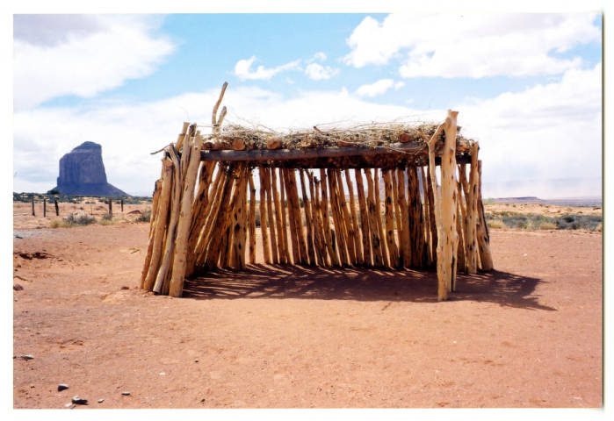
Indigenous views on Disability
1.) Navajo (Dine): Story of Early Dawn Boy
Different versions but the lessons are the same
Have compassion
2.) Hopi: Cross-Legged Kachina (Huhuwa)
He has other qualities he brings to the community: dances, jokes, composes songs,
Teaches people to be kind and respectful to each other

Slide 5
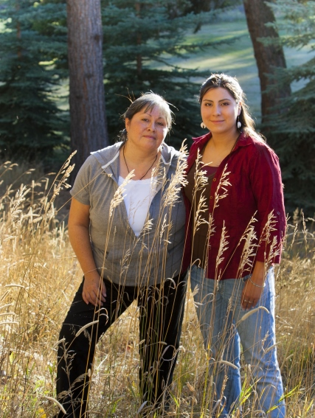
Currently
People with disabilities in Indian Country are often unserved or underserved.
Tribal communities face numerous barriers, including lack of funding, employment opportunities, day programs for adults living with developmental disabilities, staff, transportation, coordination among agencies, consultation with tribes, cultural sensitivity by non-Native staff, and systems to identify people eligible for services.

Slide 6
Understanding Disabilities in Native Communities toolkit
Reviewed the 2003 Toolkit Guide, originally published from the National Council of Disability (NCD)
Gathered a team of technical experts in the AIAN disability expert
Collaborated with the experts to pinpoint the changes needed to the toolkit

Slide 7
Accessibility
Independent Living
Education
Assistive Technology
Vocational Rehabilitation
Housing
Employment

Slide 8
Vocational Rehabilitation programs
Tribal VR programs Resources
Entrepreneurships programs within tribes

Slide 9
Independent Living
Tribal Centers for Independent Living
Assist! To Independence in AZ
Cherokee Nation Home Health Services, Inc
Culturally Informed Programs
Examples prayer, ceremony

Slide 10
Disability Etiquette
Ask before you help: Interact with the person as a person first. Don’t assume they need help
Be sensitive about physical contact: Avoid touching their wheelchair, scooter or cane. Their equipment is part of their personal space
Think before you speak:

Slide 11
Discussion Questions
What did you like about the toolkit?
What topic do you think should be included?
What topics do you think should have been talked about more?

Slide 12
Thank You!

